Slide 1
final Presentation
G5

Slide 2
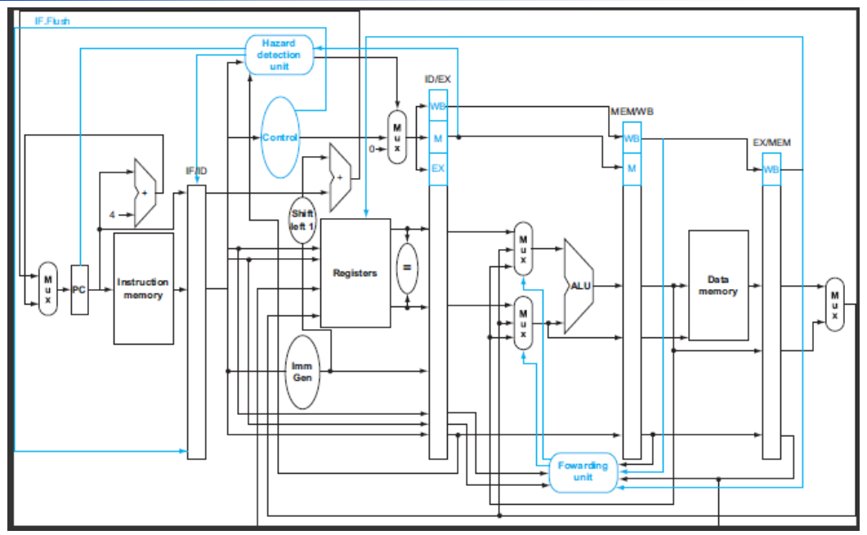
Recap:Baseline

Slide 3
Recap:Baseline
Area：238238 um^2
Cycle time：10 ns
Cycle (no hazard)：1915 ns
Cycle (has hazard)：24245 ns

Slide 4
Our Goal
ID stage forwarding
Reduce redundant x0 write operation
Cache
Extension
Compression
BP
Qsort

Slide 5
ID stage forwarding
If the data used for judging jump or branch situation had already completed, forwarding it from MEM stage to ID stage. Otherwise, add a bubble.

Slide 6
Our Goal
ID stage forwarding
Reduce redundant x0 write operation
Cache
Extension
Compression
BP
Qsort

Slide 7
Reduce redundant x0 write operation
If an instruction writing data to x0, then turn signal RegWrite to 0.

Slide 8
Our Goal
ID stage forwarding
Reduce redundant x0 write operation
Cache
Extension
Compression
BP
Qsort

Slide 9
Cache Optimization
Read-only I-cache
To solve setup time error
Register mem_ready
Save the data into register at the next cycle
If miss&dirty, first read data from memory, then write dirty block back to memory

Slide 10
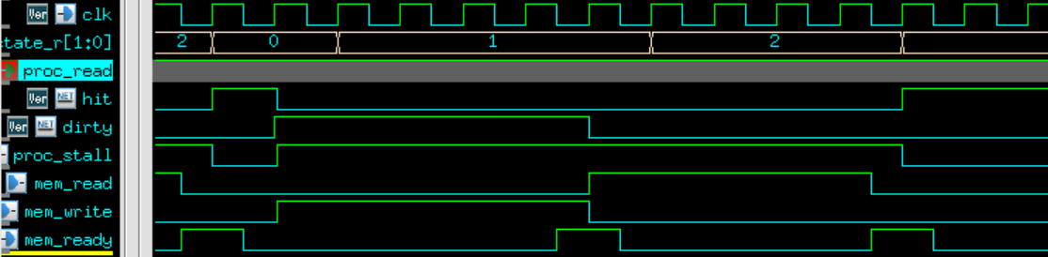
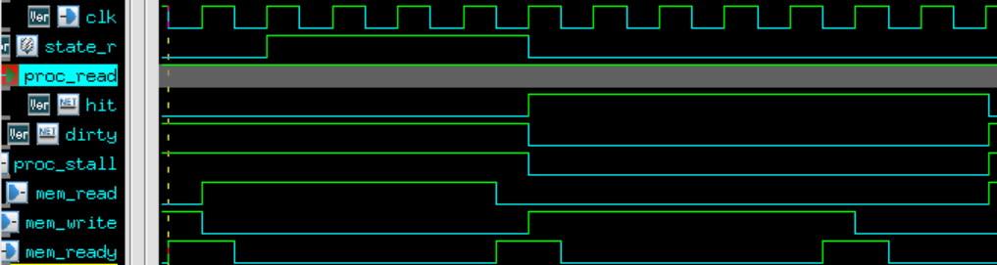
Cache Optimization
Before
miss
&
dirty
write
back
read
data
Processor stall
After
Processor can run while write back
miss
&
dirty
read
data
write
back
Processor stall
Reduce more cycles

Slide 11
Our Goal
ID stage forwarding
Reduce redundant x0 write operation
Cache
Extension
Compression
BP
Qsort

Slide 12
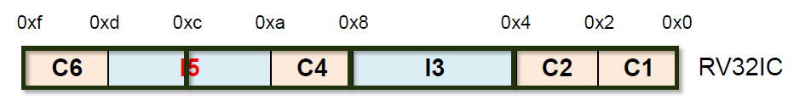
Compression
Need two cycle to fetch cross block data (I5)
Use a 16-bits buffer to store previous instruction

Slide 13
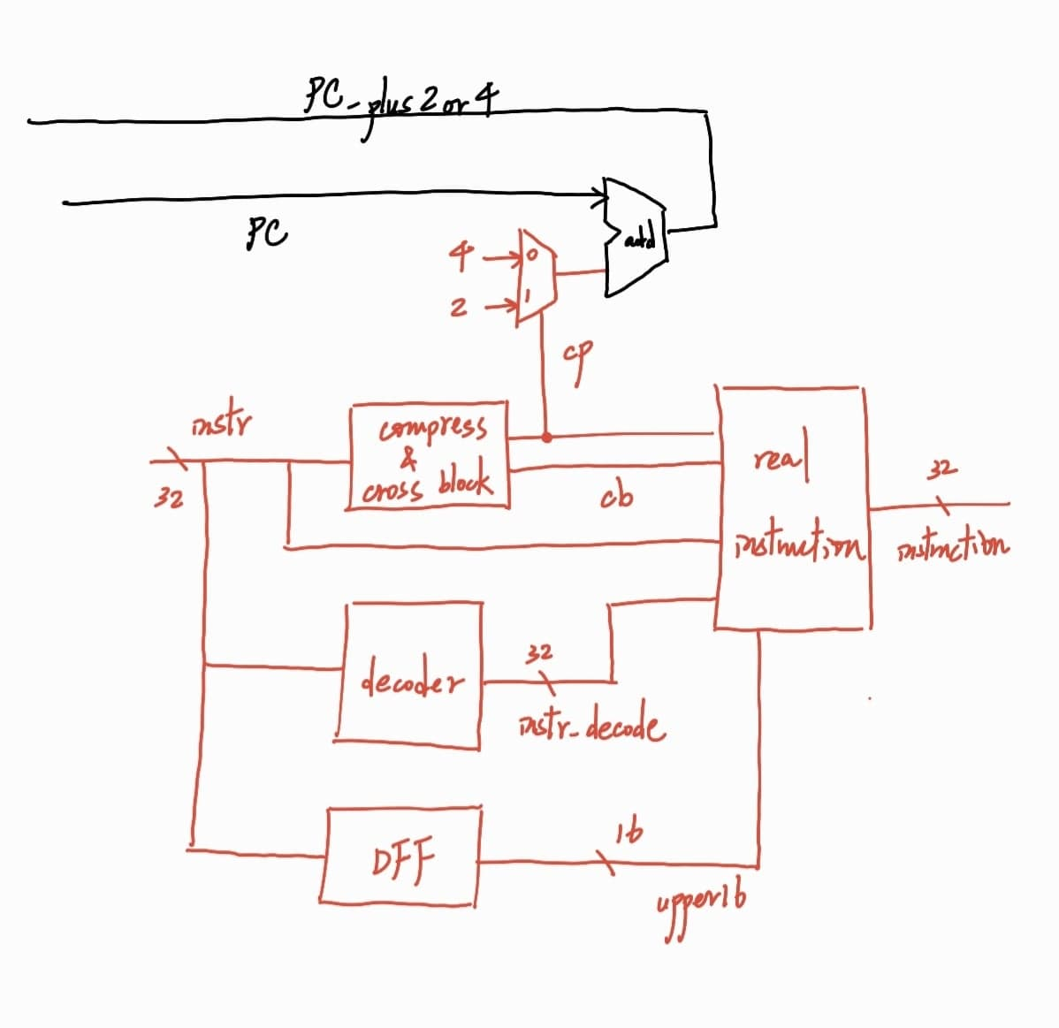
Compression

Slide 14
Compression
Need two cycles to fetch cross block data
Sol：
Read 48-bits at a time
Change cache block size to 16-bits

Slide 15
Compression Testbenches
sdc_cycle = 4.0
tb_cycle = 4.0
Always not taken
 | Timing (ns) | Area (um^2) | AT
Decompress | 2494 | 240870 | 600729780
Compress | 2114 | 253210 | 544887728

Slide 16
Our Goal
ID stage forwarding
Reduce redundant x0 write operation
Cache
Extension
Compression
BP
Qsort

Slide 17
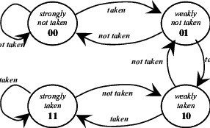
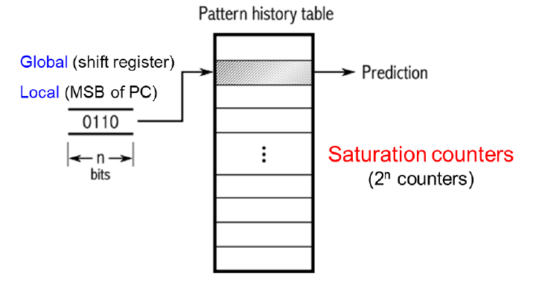
Branch Prediction
2-bit predictor
2-level 1-bit saturation predictor

Slide 18
2-level 1-bit saturation predictor(n=2)
Remembers the history of the last 2 occurrences
Works efficiently on regularly recurring pattern
Ex : a conditional jump is taken every third time
Branch sequence:001001…
0->1
0
0
0
1
0
0
0
1
0
0
0
Branch history
Branch history
Branch history
00
01
10

Slide 19
Branch Prediction Testbenches
a=10, b=20, c=30
Cycle time = 10.0 ns
Branch Prediction | Timing (ns) | Area (um^2) | AT
Always not taken | 4565 | X | X
2-bit predictor | 4495 | 228449 | 1.03*10^9
2-level 1-bit saturation predictor | 4155 | 229795 | 0.95*10^9

Slide 20
Our Goal
ID stage forwarding
Reduce redundant x0 write operation
Cache
Extension
Compression
BP
Qsort

Slide 21
QSort Testbench - Compression
sdc_cycle = 4.0
Always not taken
 | Tb_cycle | Timing (ns) | Area (um^2) | AT
Decompress | 4.0 | 673446 | 240870 | 1.62e11
Compress | 4.2 | 624378 | 253210 | 1.58e11

Slide 22
QSort Testbench – Branch Prediction
sdc_cycle = 4.0
tb_cycle = 4.6
Total 8327 branch instructions
Branch Prediction | Prediction wrong | Error rate | Timing (ns) | Area (um^2) | AT
2-level 1-bit saturation predictor | 4778 | 57.38% | 667738 | 270044 | 1.80e11
2-bit predictor | 4610 | 55.36% | 667434 | 267729 | 1.786e11

Slide 23
QSort Testbench – Branch Prediction
sdc_cycle = 4.0
tb_cycle = 4.6
Total 8327 branch instructions
Branch Prediction | Prediction wrong | Error rate | Timing (ns) | Area
2-bit predictor | 4610 | 55.36% | 667434 | bigger
Always not taken | 4885 | 58.66% | 667351 | smaller

Slide 24
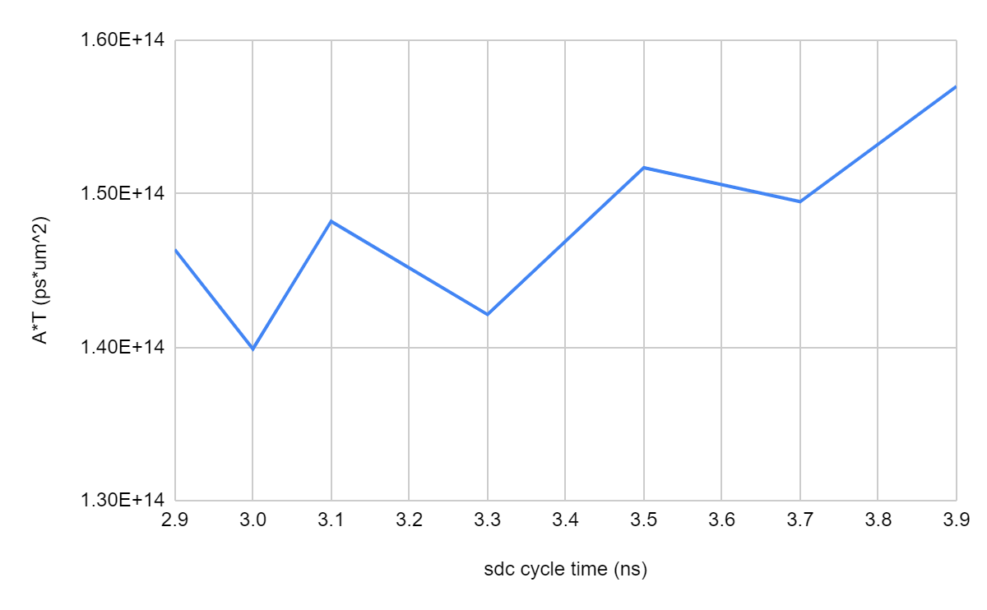
QSort Testbench
Compression
Always not taken
Sdc cycle(ns) | Tb cycle(ns) | Timing (ns) | Area (um^2) | AT
2.9 | 3.3 | 493717.95 | 296454 | 1.46*10^11
3.0 | 3.2 | 489508.8 | 285771 | 1.40*10^11
3.1 | 3.5 | 511880.25 | 289519 | 1.48*10^11
3.3 | 3.5 | 511880.25 | 277657 | 1.42*10^11
3.5 | 4.0 | 571574 | 265411 | 1.52*10^11
3.7 | 4.0 | 5717574 | 261532 | 1.49*10^11
3.9 | 4.4 | 613956.2 | 255710 | 1.57*10^11

Slide 25
Work Assignment Chart
劉心宇 | ID stage forwarding & Compression
廖苡鈞 | Branch predictor & Cache
陳俊霖 | Branch predictor & ppt

